Slide 1
Gradient descent back propagation optimization methods activation functions loss functions ann design
Veena Sarda

Slide 2
The derivative function
Let's minimize the following function
y=x²−4x+6
For x = 0, y = 6
For x = 1, y = 1-4+6=3
For x =2, y = 4-8+6=2
For x = 3, y = 9-12+6 = 3
For x = -1 , y =1+4+6=11
Derivative of above equation is 2x-4=0 hence x=2 So minimum of the function is its derivative

Slide 3
How to find minima

Slide 4
How to find minima

Slide 5
back propagation
Veena Sarda

Slide 6
Backpropagation algorithm is the cornerstone of modern neural learning
Without backpropagation, we would be unable to efficiently train our networks
Modern neural network libraries such as Keras already have (highly optimized) backpropagation algorithms built-in.
Implementing backpropagation by hand each time we wished to train a neural network would be like coding a linked list or hash table data structure from scratch each time we worked on a general purpose programming problem .
It’s unrealistic, but it’s also a waste of our time and resources
But we will understand backpropagation using a concrete example

Slide 7
x1 x2 b y
0 0 1 0
0 1 1 1
1 0 1 1
1 1 1 0
Calculate for row 2
?
x1
0.35
-0.09
0.38
0.46
?
?
1.08
x2
0.-33
-0.17
-0.17
Sigmoid Activation function
1.12
?
x3
0.54
0.-33
-0.33
Sigmoid Activation function

Slide 8
[0 1 1] * 0.35 - 0.09 0.46
1.08 - 0.17 - 0.17
1.12 0.54 - 0.33
σ[2.2 0.34 -0.5]
[0.90 0.59 0.38]
Forward pass

Slide 9
x1
0.35
0.91
-0.09
0.38
0.46
0.58
?
1.08
x2
0.-33
-0.17
-0.17
Sigmoid Activation function
1.12
0.38
b
0.54
0.-33
-0.33
Sigmoid Activation function
Forward pass

Slide 10
x1
0.35
0.91
-0.09
0.38
0.46
1.08
0.58
x2
0.-33
-0.17
0.51
-0.17
Sigmoid Activation function
1.12
0.38
b
0.54
0.-33
-0.33
Sigmoid Activation function
Forward pass

Slide 11
Backward pass – modify weight to minimise loss
δE = δE * δout * δnet
δW δout δnet δW
E = 1(actual – predicted)²
2
net
out

Slide 12
0.91
x1
0.35
-0.09
0.38
0.46
0.58
0.51
1.08
x2
0.-33
-0.17
-0.17
1.12
0.38
b
0.54
0.-33
-0.33

Slide 13
Backward pass
δE = δE * δout * δnet
δW δout δnet δW
out_{hn}
E = 1(actual – predicted)²
2
net
out
E = 1-0.51
Out_{hn} = 0.91
w=0.38
net=0.23
Out=0.51

Slide 14
Backward pass
δE = out – actual = 0.51-1 = -0.49
δout
out_{hn}
E = 1(actual – predicted)²
2
net
out
E = 1-0.51
Out_{hn} = 0.91
w=0.38
net=0.23
Out=0.51

Slide 15
Backward pass
δout = out * (1– out) = 0.51*-0.49 = -0.25
δnet
out_{hn}
E = 1(actual – predicted)²
2
net
out
E = 1-0.51
Out_{hn} = 0.91
w=0.38
net=0.23
Out=0.51

Slide 16
Backward pass
δnet = out_{hn} = 0.91
δw
out_{hn}
E = 1(actual – predicted)²
2
net
out
E = 1-0.51
Out_{hn} = 0.91
w=0.38
net=0.23
Out=0.51

Slide 17
Backward pass for any node
δE = (out-actual) * out*(1-out)* out_{hn}
δW
δE = -0.49 * -0.25 * 0.91 = 0.11
δW
out_{hn}
E = 1(actual – predicted)²
2
net
out
E = 1-0.51
Out_{hn} = 0.91
w=0.38
net=0.23
Out=0.51

Slide 18
Learning rate
w = w-η( δE ) δw

Slide 19
We can minimize error by
Adjusting neural network weights.
Weights are determined by training
Start out with initial random weights
Best to keep weights close to zero
Back-propagation:
On given input, compare actual output to desired output.
Adjust weights to output nodes.
Work backwards through the various layers
Back Propagation

Slide 20
Backward pass
In order to apply the backpropagation algorithm, our activation function must be differentiable so that we can compute the partial derivative of the error with respect to a given
Loss (Error)
Node ouput
Weight

Slide 21
There are a plethora of different nonlinear optimization methods that we can use with backpropagation:
A Few Optimization Methods:
Annealing
Stochastic Gradient Descent
AW-SGD (new!)
Momentum (SGD)
Nesterov Momentum (SGD)
AdaGrad
AdaDelta
ADAM
BFGS
LBFGS

Slide 22
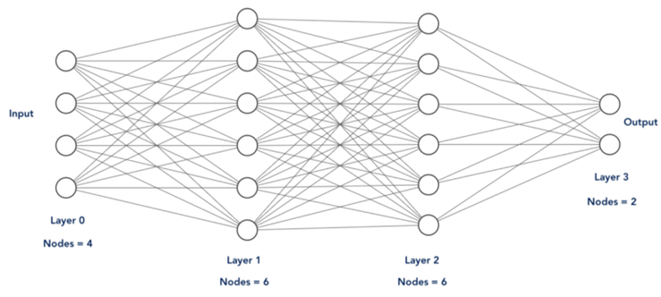
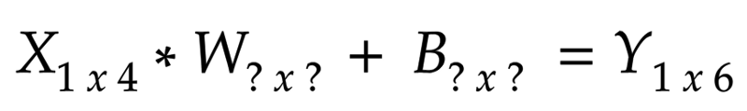
Matrix Dimensions
For any row, 1st Layer

Slide 23
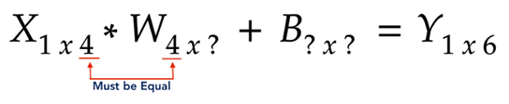
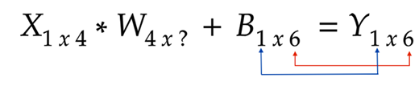
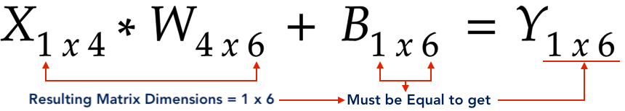
Matrix Dimensions

Slide 24

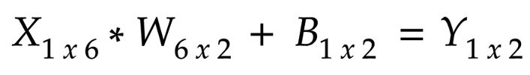
Matrix Dimensions
For 2nd Layer
For 3rd Layer

Slide 25

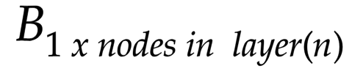
Matrix Dimensions

Slide 26
Graphs of derivatives of activation functions

Slide 27
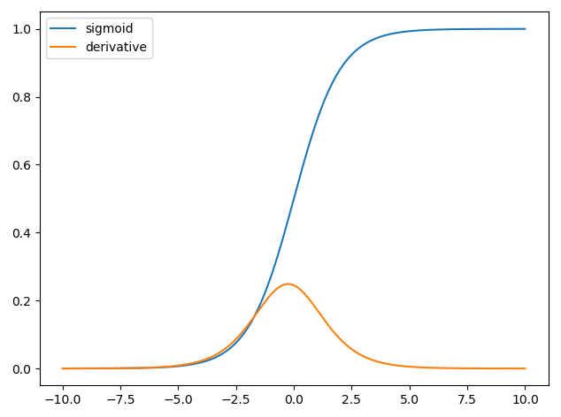
Derivative of Sigmoid

Slide 28
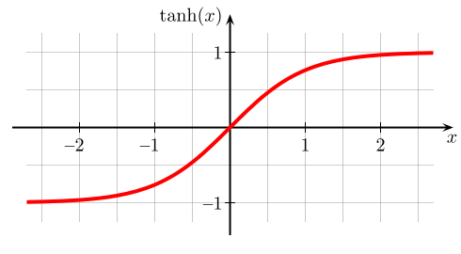

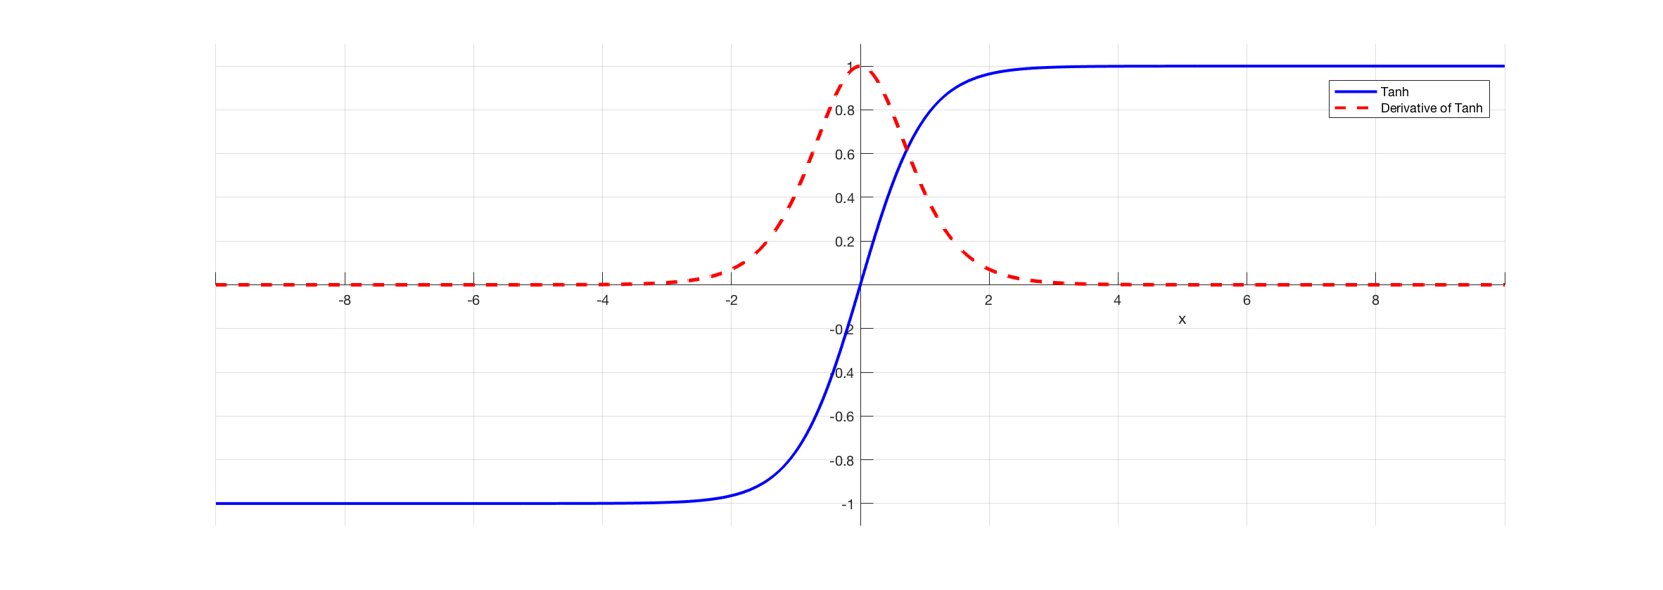


$$\tanh\left(x\right)= \frac{e^{x}−e^{−x}}{e^{x}+e^{−x}}$$
Notes:
Full list: https://en.wikipedia.org/wiki/Activation_function

Slide 29
Activation function activity
Plot derivatives of Relu and Threshold functions

Slide 30
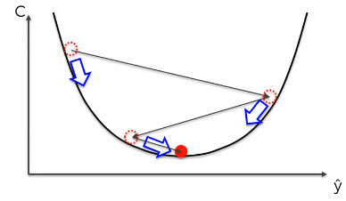
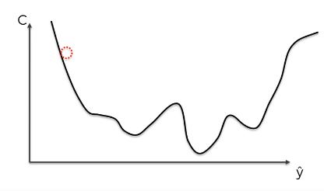
Stochastic Gradient Descent
Gradient Descent requires a convex function and has one global minimum

Slide 31
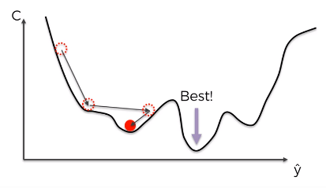
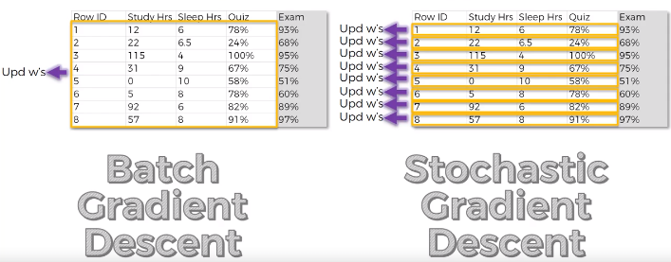
Stochastic Gradient Descent

Slide 32
Mini Batch Gradient Descent
Take batches of rows and perform gradient descent

Slide 33
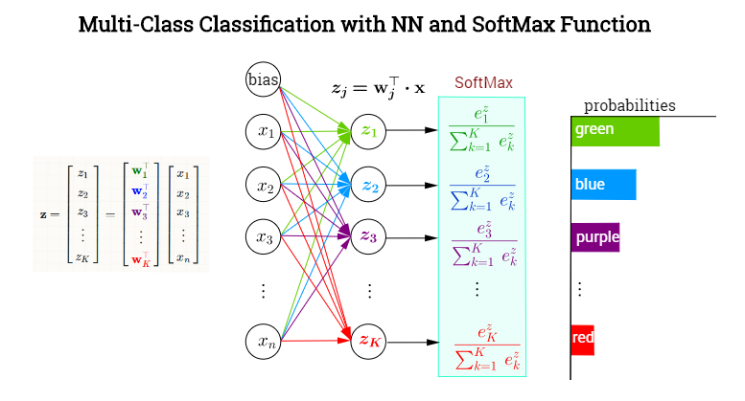
Softmax activation function

Slide 34
A loss function (or objective function, or optimization score function) is one of the two parameters required to compile a model
categorical_crossentropy - If your targets are one-hot encoded, use categorical_crossentropy.
sparse_categorical_crossentropy - if your targets are integers, use sparse_categorical_crossentropy.
binary_crossentropy
Mean Squared Error
Loss Functions

Slide 35
Loss Functions
Regression Loss Functions - A regression predictive modeling problem involves predicting a real-valued quantity.
Mean Squared Error Loss
Binary Classification Loss Functions - Binary classification are those predictive modeling problems where examples are assigned one of two labels.
Binary Cross-Entropy
Multi-Class Classification Loss Functions - Multi-Class classification are those predictive modeling problems where examples are assigned one of more than two classes.
Multi-Class Cross-Entropy Loss
Sparse Multiclass Cross-Entropy Loss

Slide 36
ANN Training
Overtraining
An ANN can be made to work too well on a training set
But bad performance on test sets
Training set
Performance
Test set
Training time

Slide 37
ANN Design
Number of layers
Apparently, three layers is almost always good enough and better than four layers.
Also: fewer layers are faster in execution and training
How many hidden nodes?
Many hidden nodes allow to learn more complicated patterns
Because of overtraining, almost always best to set the number of hidden nodes too low and then increase their numbers.

Slide 38
Thank you

